Slide 1
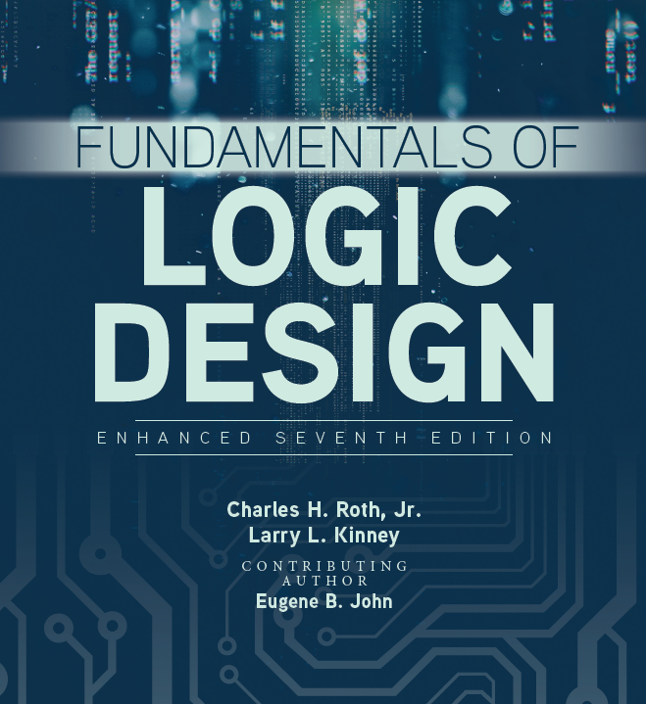

Unit 2
Boolean Algebra

Slide 2

Review
W X Y Z 𝐹

Slide 4
 | X | 0 | 0 | 1 | 1
 | Y | 0 | 1 | 0 | 1
(AND) (OR) | X ∙ Y X + Y
(NOT) | X'
Time diagram shows waveform behavior

Slide 5
Boolean algebra
Boolean Algebra is an algebra dealing with binary variables and logic operations.
A Boolean expression is an algebraic expression formed by using binary variables, the constants 0 and 1, the logic operation symbols, and parentheses
The order of evaluation in a Boolean expression:
( ), NOT, AND, OR

Slide 6
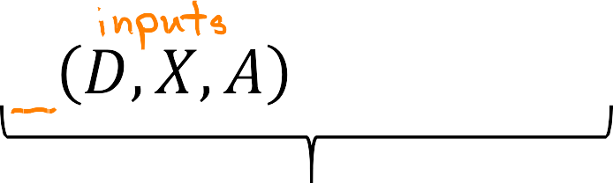




Boolean functions
A Boolean function is a Boolean equation consisting of a binary variable identifying the function followed by an equal sign and Boolean expression
’
Boolean function or Boolean equation
A Boolean function can be transformed into a circuit diagram (logic diagram) composed of logic gates and interconnected by wires

Slide 7

Boolean Operations and Truth Tables
Examples of Boolean Expressions and Corresponding Diagrams:
Expressions
Order of operations- Parentheses, Inversion, AND, OR
Logic Diagrams

Slide 8
Boolean Operations and Truth Tables
Truth Tables:
A truth table specifies the values of a Boolean expression for every possible combination of values of the variables in the expression.
F=A’+B

Slide 9
Boolean Operations and Truth Tables
Equal Boolean Expressions:
Two boolean expressions are said to be equal if they have the same value for every possible combination of the variables. See Table 2-1 in the text.
An n-variable expression will have 2^{n} rows in its truth table.

Slide 10
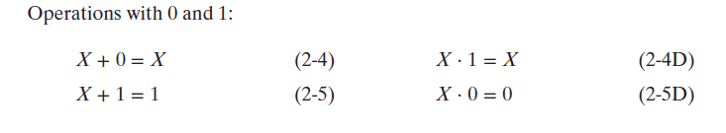
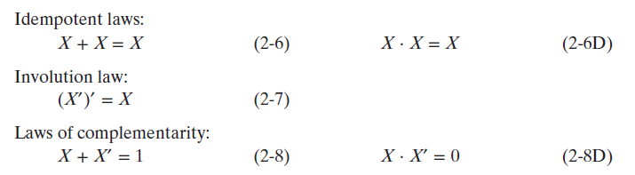
Basic Theorems
Single Variable Basic Theorems:

Slide 11
Commutative, Associative, Distributive and DeMorgan’s Laws
Commutative and Associative Laws:
Commutative: Order in which variables are written does not affect result of applying AND and OR operations.
XY= YX and X+Y= Y+X
Associative: Result of AND and OR operations is independent of which variables we associate together first.
(XY)Z=X(YZ)=XYZ
(X+Y)+Z= X+(Y+Z)=X+Y+Z

Slide 12
Commutative, Associative, Distributive and DeMorgan’s Laws
Distributive Law:
The distributive law of boolean algebra is as follows:
X(Y+Z)= XY+XZ
Furthermore, a second distributive law is valid for Boolean algebra but not ordinary algebra:
X+YZ= (X+Y)(X+Z)

Slide 13
Commutative, Associative, Distributive and DeMorgan’s Laws
DeMorgan’s Laws:
DeMorgan’s Law is stated as follows:
(X+Y)’=X’Y’
(XY)’=X’+Y’

Slide 14
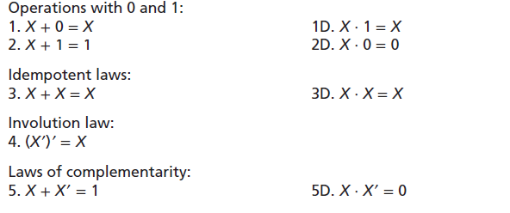
Commutative, Associative, Distributive and DeMorgan’s Laws
Laws of Boolean Algebra (Table 2-3):

Slide 15
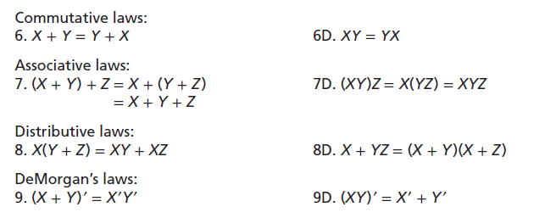
Commutative, Associative, Distributive and DeMorgan’s Laws
Laws of Boolean Algebra (Table 2-3 continued):

Slide 16
Multiplying Out and Factoring
Sum of Products:
An expression is said to be in sum-of-products (SOP) form when all products are the products of single variables. This form is the end result when an expression is fully multiplied out.
For example:

Slide 17
Multiplying Out and Factoring
Product of Sums:
An expression is in product-of-sums (POS) form when all sums are the sums of single variables. It is usually easy to recognize a product-of-sums expression since it consists of a product of sum terms.
For example:

Slide 18
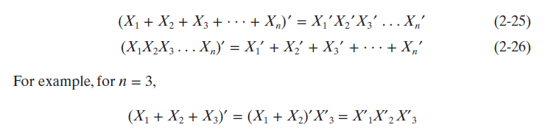
Complementing Boolean Expressions
Using DeMorgan’s Laws to find Inverse Expressions:
The complement or inverse of any Boolean expression can be found using DeMorgan’s Laws.
DeMorgan’s Laws for n-variable expressions:
The complement of the product is the sum of the complements.
The complement of the sum is the product of the complements.

